Slide 1





5/17/2025

Slide 2
Project Title: MTA Daily Ridership Analysis
About the data :Analysis of New York City's daily transit ridership before and after the COVID-19 pandemic
Presenter's Name: Mohamed Alaa Mahmoud
Date :5/17/2025
5/17/2025
1

Slide 3
Project idea
-New York City has experienced a sharp decline in public transit ridership due to the COVID-19 pandemic, impacting daily commuting patterns.
-Proposed solution: Analyze daily MTA ridership data to understand changes in behavior and provide recommendations for service improvements.
-Value added: Provide data-driven insights to support informed decision-making in urban transportation planning
5/17/2025
2

Slide 4
Why did we choose this project?
New York City is one of the world's busiest cities.
The COVID-19 pandemic has had a significant impact on commuting habits.
We aimed to understand this impact by analyzing MTA data.
3
5/7/2025
2

Slide 5
5/17/2025
Analysis Objectives
Comparing passenger volume before and after the pandemic.
Identifying new passenger behavior patterns
Offering strategic recommendations to transit authorities, data analysts, and decision-makers for enhancing transportation services
17/5/2025
4

Slide 6
Key Business Questions
-To what extent have passenger numbers decreased?
What are the busiest days and seasons?-
Has transportation recovered after the COVID-19 pandemic?-
17/5/2025
5

Slide 7
Data and Tools Used
-Data Source: MTA Ridership Daily Reports.
:Analysis Tools-
Power BI :For analysis and visualization
Power Query :For data cleaning and transformation
Power BI Service: For sharing the dashboard.
Excel :Original data source
-Techniques: Data Cleaning, DAX Calculations, Dynamic Dashboards
17/5/2025
6
4

Slide 8
Data Model and Preparation
Source: Excel file with-
14 Measure Columns (e.g., total ridership, recovery %)
2Dimension Columns (date, transport mode)
Data Model: Star Schema Model in Power BI-
Dim Calendar
Dim Transport Mode
Fact MTA Daily Ridership
:Cleaning Steps-
Unpivot data
Remove duplicates
Build dimension/fact tables via Power Query
Data Dictionary: Key Columns Explanation-
7
17/5/2025
4

Slide 9
Post Pandemic, Pandemic and Recovery Rate by Pre Transport Mode
Subways: Highest pre-pandemic ridership, with significant declines and a low recovery rate
Buses: Second-highest utilization, with a better recovery rate than trains
Bridges and Tunnels: Relatively stable performance and average recovery
LIRR and Metro-North: Declining utilization and weak recovery rates
Access-A-Ride: Good recovery rate relative to utilization
Staten Island Railway: Lowest recovery rate among all modes of transportation
Note: Recovery remains uneven and has not reached pre-pandemic levels
9
17/5/2025
4

Slide 10
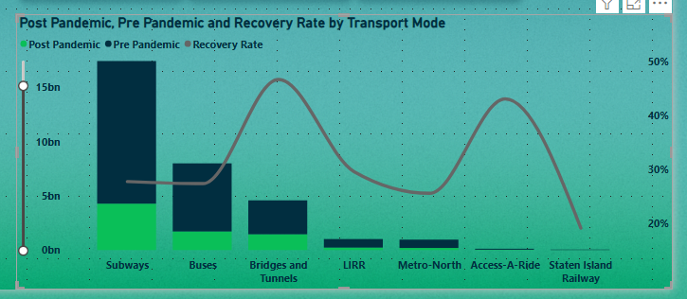
Post Pandemic, Pre Pandemic and Recovery Rate by Transport Mode
8
17/5/2025
4

Slide 11
Total Ridership by Day and Year
:Weekdays (Tuesday - Thursday)
Highest ridership levels across all years, especially pre-pandemic years, but showing noticeable declines post-2020
:Weekends (Saturday - Sunday)
Significant drops in ridership, with very limited recovery over the years compared to weekdays
:Fridays and Mondays
Moderate ridership levels, slightly higher than weekends but still lower than mid-week peaks
:2020 Data
Lowest ridership across all days due to the impact of the COVID-19 pandemic, with slow recovery afterwar.
:2021 and 2022 Data
Gradual but uneven recovery, mainly during weekdays; weekends remained weaker
:2023 and 2024 Data
Clear signs of better recovery, particularly on weekdays, but still not reaching pre-pandemic peaks
:Overall Note
Recovery across all days remains incomplete and varies significantly between weekdays and weekends
Pre-pandemic ridership levels have not been fully restored
11
17/5/2025
4

Slide 12
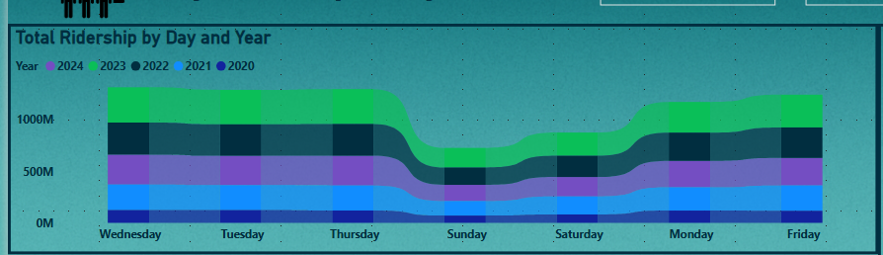
Total Ridership by Day and Year
10
17/5/2025
4

Slide 13
Pre - Post Pandemic Ridership by Seasons
Comparative Notes:-
Winter ridership remained stable at 20.48% across both periods
Spring was the highest before the pandemic, while fall became the highest after the pandemic
Summer, spring, and fall ridership rates were closely aligned after the pandemic
The difference between the highest and lowest seasons in terms of ridership remained clear, with winter consistently the lowest.
-:Conclusions
There has been little change in transit usage patterns after the pandemic, with increased use of transit in the fall compared to spring
The changes may be due to changing work patterns, weather changes, or changes in individual behavior after the pandemic
13
17/5/2025
5

Slide 14
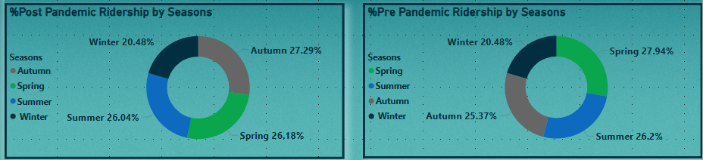
Pre - Post Pandemic Ridership by Seasons
12
17/5/2025
5

Slide 15
Weekend vs Weekday Ridership Analysis
-Additional Notes:
Autumn was the season with the highest number of passengers after the pandemic, while winter recorded the lowest traffic rates
Ridesharing is significantly lower on weekends than on weekdays
Long-distance modes of transportation (such as Metro-North and LIRR) experience greater declines in use on weekends than local modes
Conclusions-
Commuting is primarily weekday-based, reflecting its connection to work and school
The higher use of bridges and tunnels on weekends may indicate increased personal and recreational travel compared to other modes of transportation.
15
17/5/2025
5

Slide 16
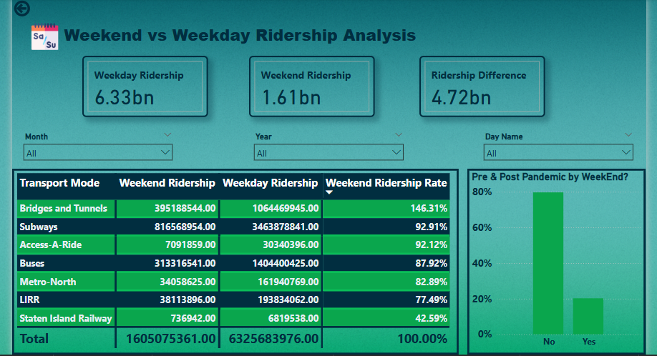
Weekend vs Weekday Ridership Analysis
14
17/5/2025
5

Slide 17
Live Application + Test
-Current Status:
The project has been uploaded to Power BI Service and is currently under review (an interactive view is available for the team).
:Testing Phases-
DAX Functionality Testing
Relationship Testing
User Experience Testing (by the team)
:Quality Notes-
All calculated measures display accurate results
Navigation within the dashboards is smooth and provides a clear visual experience
16
17/5/2025
5

Slide 18
Insights
Subways: Highest ridership pre-pandemic, with significant declines and a low recovery rate
Buses: Second-highest utilization, with a better recovery rate than trains
Bridges and Tunnels: Relatively stable performance and average recovery
LIRR and Metro-North: Declining utilization and weak recovery rates
Access-A-Ride: Good recovery rate relative to utilization
Staten Island Railway: Lowest recovery rate among all modes
Note: Recovery remains uneven and has not reached pre-pandemic levels
17
17/5/2025
5

Slide 19
Recommendations
Launch awareness campaigns to build confidence in public transportation by highlighting hygiene and safety standards.
Improve and promote LIRR and Staten Island Railroad services to support recovery
Exploit peak days, such as Wednesdays, and busy seasons through promotions and attraction events
Incentivize public transit use during weekends through discounts and marketing partnerships
Improve Staten Island Railroad services, especially during holidays, by improving schedules and service quality
Leverage post-pandemic analytics to develop strategies to restore user confidence and increase demand
18
17/5/2025
5

Slide 20
Conclusion
COVID-19 led to a major shift in public transit usage patterns
Although recovery is underway, pre-pandemic levels are not yet fully reached
Data-driven strategies are crucial for smarter urban mobility planning
19
17/5/2025
13

Slide 21
Final Deliverables
:Reports and Documentation-
Final Report (PDF)
Power BI File (PBIX)
Presentation (PPT)
:Timeline-
Project work began in November 2024
Completed in April 2025
:Final Outputs-
Interactive dashboard published on Power BI Service
Supporting documents and a shared team folder
17/5/2025
20
5

Slide 22
Project Team & Roles
-Team Members:
Mohamed Alaa :Team Leader & Core Model Developer-
-Haneen El-Sayed : Data Preparation & Cleaning
Ahmed Baghdadi :Research Support & Data Validation-
-ganna Saad : Data Analysis & Presentation-
Karim Mahmoud : User Experience Testing & Optimization-
Hady Khaled :Final Report Documentation & Formatting-
:Collaboration Tools & Workflow-
Weekly meetings conducted via Zoom
Task management and coordination using Trello and other tools
Internal reviews and file sharing through OneDrive, SharePoint, and supplementary platforms
17/5/2025
17/5/2025
21
13

Slide 23
Thank you
Thank you for your attention and time.
We truly appreciate the opportunity to present our project.
We look forward to your questions, feedback, and suggestions!
17/5/2025
22
13

